Slide 1
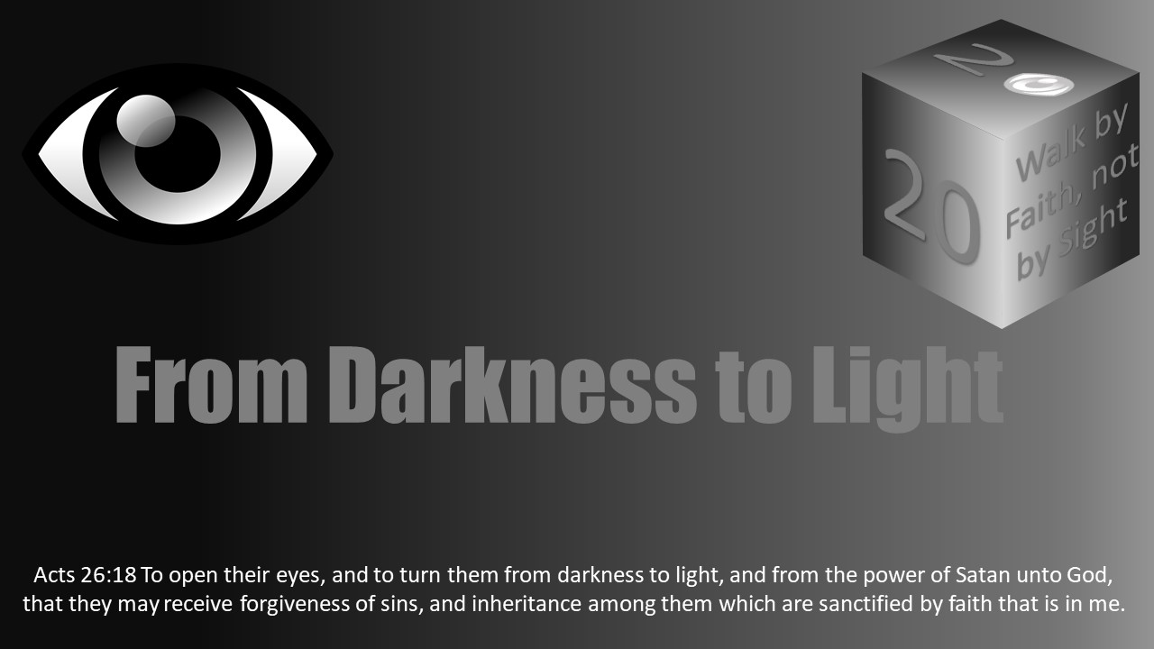


Slide 2

Darkness Lesson 25 Being Blind to the light

Slide 3
Isaiah 42:18-19
“Hear, ye deaf; and look, ye blind, that ye may see. Who is blind, but my servant? or deaf, as my messenger that I sent? who is blind as he that is perfect, and blind as the LORD'S servant?”

Slide 4


Light is used to help us see the way in dark locations.
It frees us to do many things that are impossible to do in the dark.
Light in the Bible is compared to God the father, Jesus, and His word. I
n 1 John 1:5, we read, “This is the message which we have heard from Him and declare to you, that God is light and in Him is no darkness at all.”

Slide 5
God is light and in Him is no darkness at all.”
Jesus said of himself in John 8:12, “Then Jesus spoke to them again, saying, ‘I am the light of the world. He who follows Me shall not walk in darkness, but have the light of life.’ ”
II Cor 4:4 the word of God is referred to as the “light of the gospel.” God’s word lights our way in a world darkened by sin.
So how, or why, do people become blind to the light of the gospel?

Slide 6
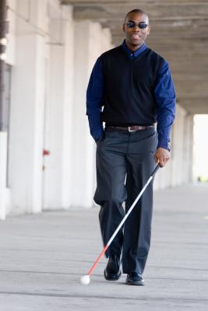
Let us compare spiritual blindness to physical blindness.
How can a person’s eyes be physically blind to the light that is around them?
They may be born blind.
Their blindness may be the result of an injury or illness.
Or, they may simply choose to close their eyes or to wear a blindfold so they cannot see the light.

Slide 7

There are different situations where we may choose to blind ourselves to the light.
For, example, children will cover their eyes to what is happening around them when they are scared.
When flying long distances, I have worn blinders to block the light because it bothered me and kept me from sleeping.
Why would someone want to spiritually blind themselves from the light of truth?
John 3:19-21, “and this is the condemnation, that the light has come into the world, and men loved darkness rather than light, because their deeds were evil. For everyone practicing evil hates the light and does not come to the light, lest his deeds should be exposed. But he who does the truth comes to the light, that his deeds may be clearly seen, that they have been done in God.”
People may choose to be blind to the truth because they do not want the evil in their lives to be shown to themselves or others.
Acknowledging your sin can bring guilt and the need to change. Many believe they can avoid this by hiding from the truth.

Slide 8
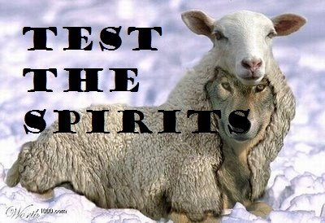
Physical blindness may result from an injury or illness.
Spiritually, I would equate this to being led astray by false teaching, whether from a false teacher or our own wrong use of God’s word.
False teaching is a form of spiritual injury from which the injured person may never recover.
2 Pet 2:1-2. “But there were also false prophets among the people, even as there will be false teachers among you, who will secretly bring in destructive heresies, even denying the Lord who bought them, and bring on themselves swift destruction. And many will follow their destructive ways, because of whom the way of truth will be blasphemed”.

Slide 9
To recognize these false teachers, we need to test the spirits as instructed in 1 John 4:1, which requires knowledge of God’s word.
A lack of knowledge of God’s word can also result in our own misuse of the scriptures.
As Peter spoke of the epistles from Paul in 2 Peter 3: 16, he commented there are “things hard to understand” and that “untaught and unstable people twist to their own destruction, as they do also the rest of the Scriptures.”
To guard against falling into this trap, we must “be diligent to present yourself approved to God, a worker who does not need to be ashamed, rightly dividing the word of truth” (2 Tim 2:15).

Slide 10
Spiritual Blindness
Finally, a person can be born physically blind, but as far as being born spiritually blind is concerned, this is where the analogy fails.
The Bible teaches God wants all to come to repentance (2 Pet 3:9) and that Jesus died for all (Rom 6:10).
Therefore, there is nobody who is born completely blind to the truth and has no hope of ever seeing the truth.
Fortunately, spiritual blindness does not have to be permanent. It can be corrected, but it takes a softening of the heart and a willingness to submit to God.
Let us open our eyes to the truth, and allow it to light our path.

Slide 11
